Slide 1
Data Science HW3
Global Optimization
2022/05/03~2022/05/24

Slide 2
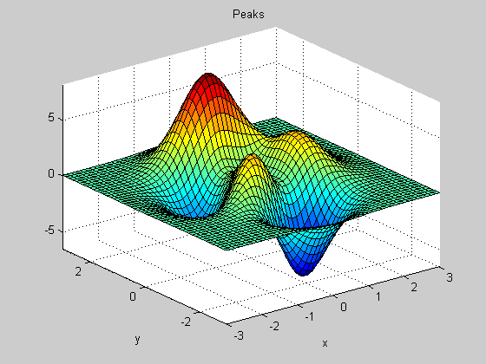




Goal
Given an unknown function, you need to design the algorithm to find the global minimum via function evaluations.
The example above, we could speculate that the bigger the inputs the smaller the objective value.
So the global minimum may be in area with bigger inputs
(It may not be like this in reality)
Function
$$(0,0)$$
$$F\left(0,0\right)=0$$
$$(0,2)$$
$$F\left(0,2\right)=−2$$
Example objective function

Slide 3
Function Operations
We provide a python encrypted file, and it includes a class Function.
Function_num: 1 ~ 4, which represents the objective function number.
Operations: (your optimizer should inherit the Function class)
self.f.dimension(function_num)
self.f.upper(function_num)
self.f.lower(function_num)
self.f.evaluate(function_num, input_parameters)
Function_num and return value of dimension are integer, and the other parameters and return values are float.
Input_parameters is floating point array.

Slide 4
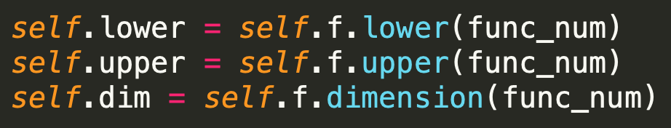
Function Operations Example
The figure below is showing how to get the dimension, upper bound, lower bound and objective value of function (all by using self.f)

Slide 5
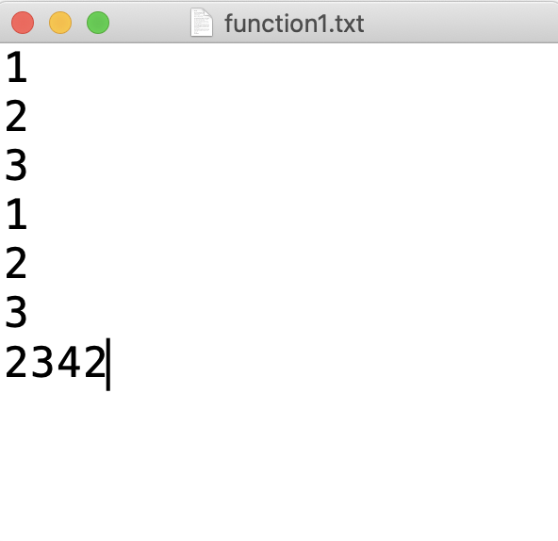
Output Files
You need to output 4 files, each for the best input parameters and its output value you find for function 1 ~ 4 (one value per line)
File names：
“your student ID”_function1.txt
“your student ID”_function2.txt
“your student ID”_function3.txt
“your student ID”_function4.txt
It has been written in the template code we provide
(you only need to modify student ID)

Slide 6
Submission Requirement and Execution Environment
Submission File:
“your student ID”_hw3.py
Environment:
OS: Ubuntu 20.04.4 LTS
CPU: AMD Ryzen 9 5900X
Python version: 3.8.10
Numpy version: 1.22.3
Sourcedefender version: 10.0.2

Slide 7
Baseline and Limit of Function Evaluation Times
We limit the function evaluation times, if the times exceed the limit, it will only return “ReachFunctionLimit”.
We will run your submission code in our server.
The other Better Baseline: Which is the worst result among CMA-ES, CoDE, EDA/LS.
Public function baseline: | TA’s Random Search objective value | TA’s other Better Baseline objective value | Limit of function evaluation times
Function 1 | 0.036 | 1.875e-6 | 1000
Function 2 | 0.381 | 4.042e-9 | 1500
Function 3 | 13.427 | 0.210 | 2000
Function 4 | 67.743 | 0.530 | 2500
Private function baseline: | TA’s Random Search objective value | TA’s other Better Baseline objective value | Limit of function evaluation times
Function 1 | 19.685 | 0.412 | 1000
Function 2 | 15.215 | 8.066 | 1500
Function 3 | 2246.339 | 1620.202 | 2000
Function 4 | -4.155 | -7.738 | 2500

Slide 8
Grading
4 public functions, 15 points for each. And the other 4 private functions, 10 points for each.
RS result < Your result:
0%
The other better baseline result < Your result < RS result:
Top 1/2: 60%
Otherwise: 40%
Global minimum < Your result < The other better baseline result:
Top 1/4: 95%
2/4: 90%
3/4: 85%
Other: 80%
Your result = Global minimum:
100%

Slide 9
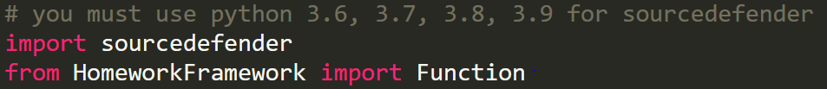
Other Announcements
We provide a python template code, which has implemented random search baseline.
You could design your algorithm and directly modify it.
You need to pip install sourcedefender, so that you can use the encrypted pye file which we provide. （Official website link：https://pypi.org/project/sourcedefender/)
We provide a HomeworkFramework.pye file in this homework.
You need to inherit Function in this file to call self.f
You must output your result in 5 minutes.
We will kill your process after 5 minutes, if you do not output the result, you will get 0 points.

Slide 10
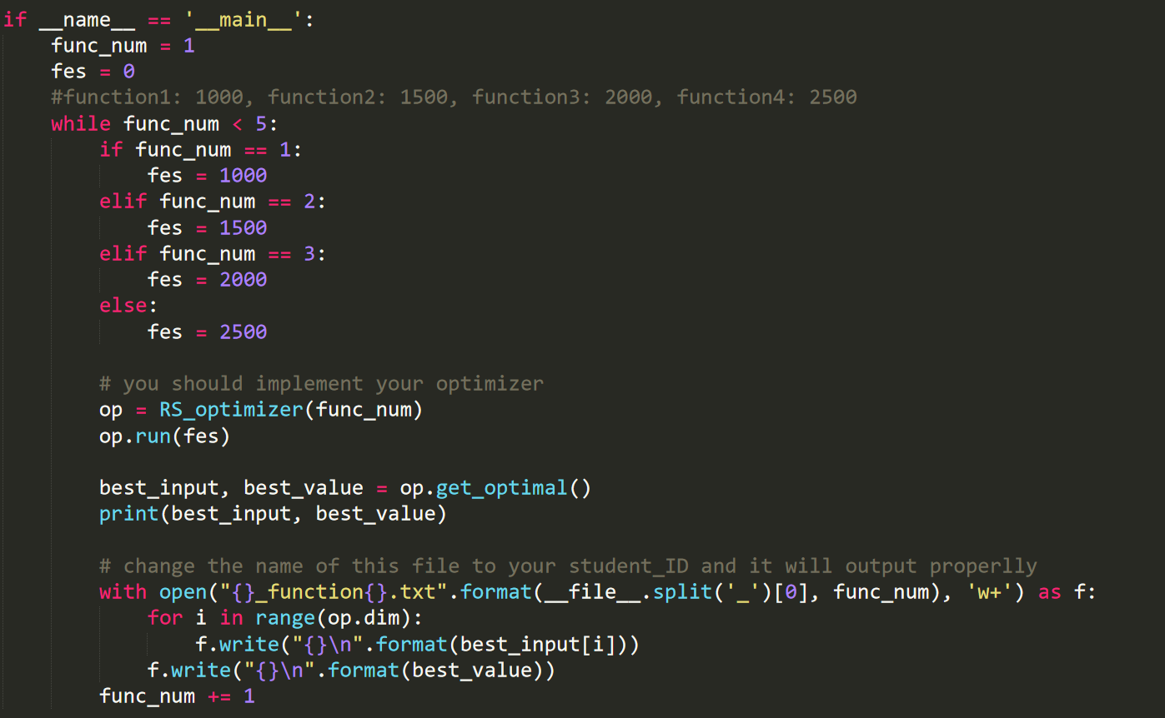
Template Code
The basic initialization and file saving have been finished, you only need to implement your own optimizer.
You could declare evaluation times here. (Because times will be calculated in pye file, if you manually adjust a bigger number, you can not get more function evaluations)
Call the optimizer here.
This is the main part you should implement
in this homework
Please make sure that your submission file is “student ID”_hw4.py, so that it can output correctly.

Slide 11
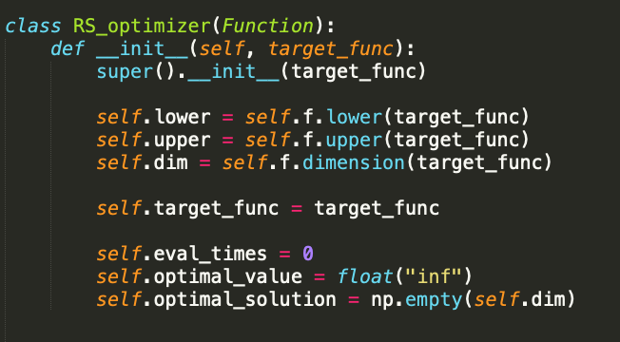
Template Code
Use self.f to get the information of function

Slide 12
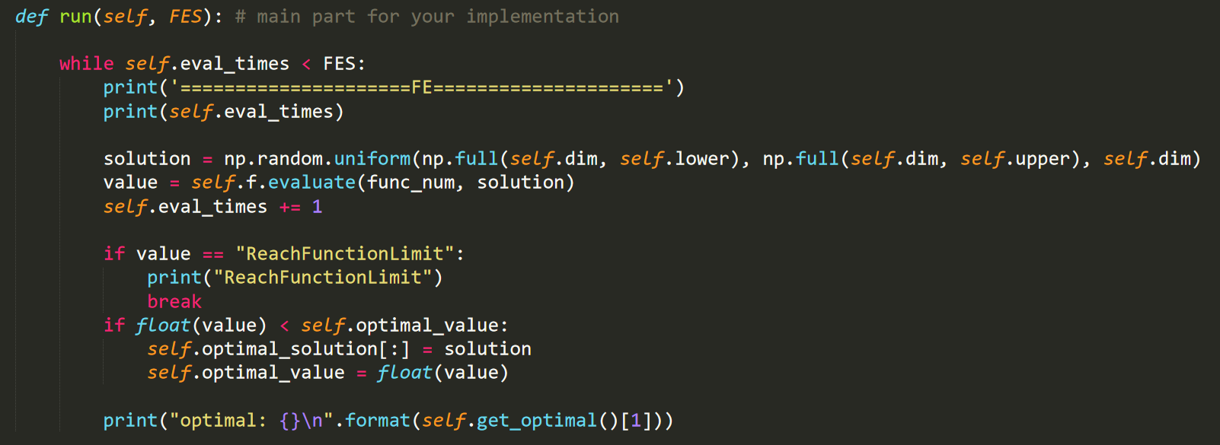
Template Code
The main part you need to implement is run().
You could modify initial if you need.
You can get the return value by calling self.f.evaluate(func_num, input_paramerts) and use this information to do optimization.

Slide 13
Supplement
Sourcedefender package website: https://pypi.org/project/sourcedefender/
Paper list:
CMA-ES: https://arxiv.org/abs/1604.00772
CoDE: https://ieeexplore.ieee.org/document/5688232
EDA/LS: https://ieeexplore.ieee.org/document/7001197
HW3 TA’s email: cy.hung.1999@gmail.com
If you have any questions, please put questions in the EEclass or send me
the letter.

